Slide 1
Xbox Game pass Presentation
By Liam, Eoin, Naoise and Nathan

Slide 2


Research and Testing
When choosing an Idea, we wanted to pick something outside the box. We researched, useability and how users interact with the Xbox interface.
We Analyzed the current lineup of games on the service and the target audience of the users when selecting games for the project.
We compared it to other services like PlayStation plus and how we could compete with their strengths and weaknesses.

Slide 3


Our Project
This project helps you look for the perfect game to play by searching through genres and how recently it was released. It Simplifies the search for discovering new games to add to you Library from the Xbox Store.​
It features user reviews and a search filter to help narrow down your search price range, release date, rating and more.

Slide 4



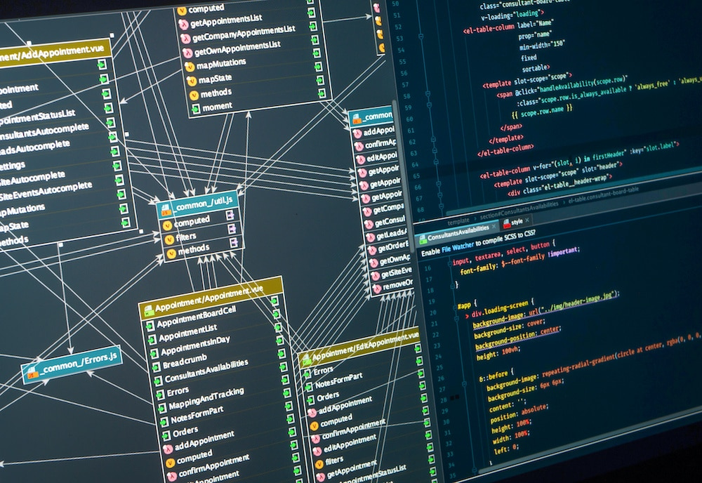
SQL
SQL or Structured Query Language is a domain- specific Language used to manage Data. It is used to communicate with a certain database. it is the standard language for relational database management systems.
SQL statements are used to perform tasks such as update data on a database or retrieve data from a database. It is used by Facebook, Microsoft and LinkedIn. SQL was ranked with the most users using databases in 2021.

Slide 5



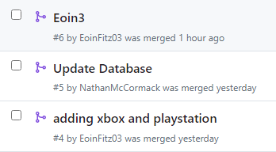
Working As a Team
As a team of 4 we spread out the team tasks so we could complete the project easier and make it all round more efficient.
We all tackled certain tasks for the project as we wanted to all finish with a high-quality output for the database.
We collaborated on GitHub to track tasks and manage progress easily.

Slide 6


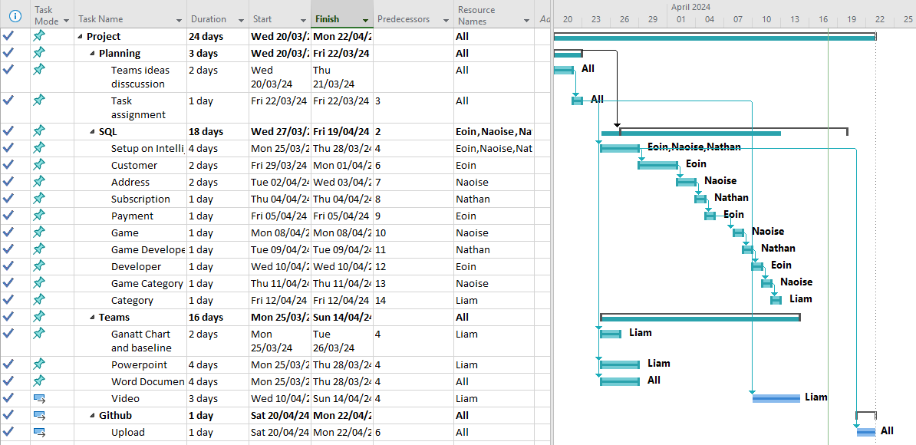
Gantt Chart

Slide 7



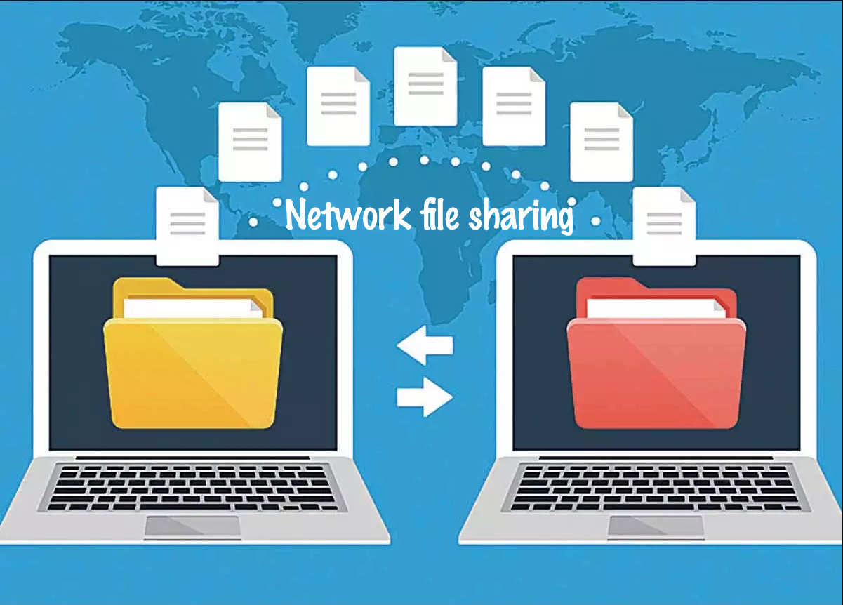
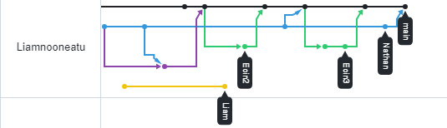
GitHub
We used GitHub to keep up with our separate workload's that we were doing. We shared our code after every big change we made to the project on separate branch's. To ensure we never overwrote other people code in main.
It was very helpful using version control and allowed us to manage our project efficiently. We were all able to clone the existing project and perform our own changes separately
GitHub is also very secure and allowed us to rest assured that our project would be safe from hackers and not have our repository as a security risk.

Slide 8
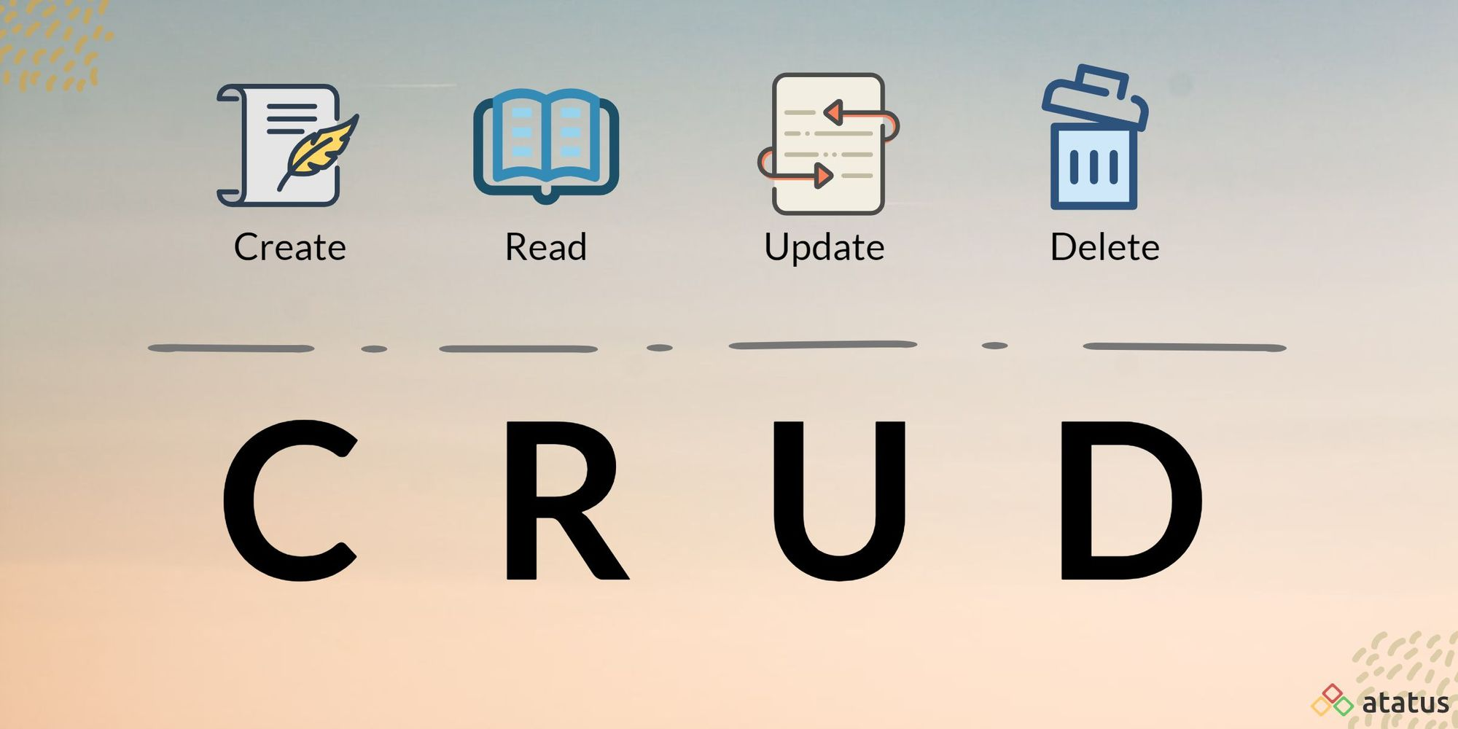
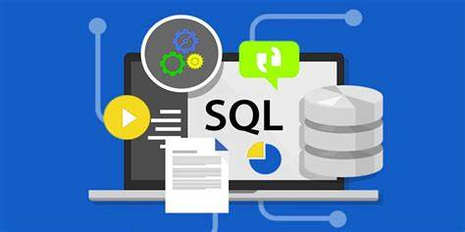
Database Normalization and CRUD
We used Database normalizations to create and organise separate tables containing game titles and genres.
CRUD (Create, Read, Update, Delete) operations were required for database management and regularly used in various applications.
By including CRUD operations to check game titles and genres, the database can be updated to show differences to the set of games. These operations allowed us to add new games, modify existing games, and remove old information, ensuring that we show the user the most up to date content on the service.

Slide 9
Testing

Slide 10
Testing

Slide 11
Testing

Slide 12
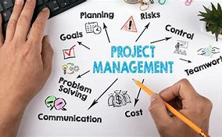

What we learned from the project
Overall, we learnt that working together on a project is much easier when working togeather in a group.
We all improved on our technical skills and coding languages when using SQL and Javascript for our database creation.
We navigated through tough challenges and roadblocks by disscussing with the team on what we could do to overcome these issues.
We applyied our knowledge and skills from past labs to help us create this project and overall, we are very happy with the Outcome.

